Slide 1
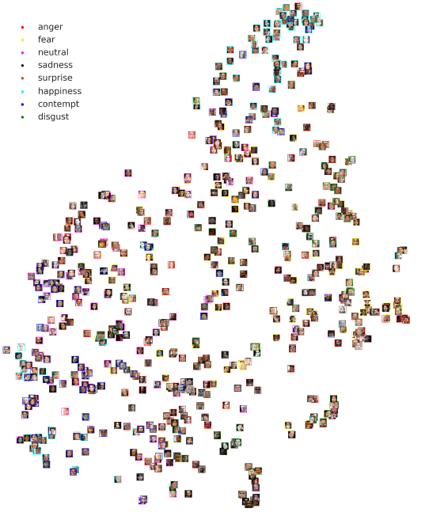
A Compact Embedding for Facial Expression Similarity
Supervisor: Jun-Cheng Chen
Speaker: Yu-Ju Ku
_{2019/11/29}
Vemulapalli, R., & Agarwala, A. (2019). A Compact Embedding for Facial Expression Similarity. In Proceedings of the IEEE Conference on Computer Vision and Pattern Recognition (pp. 5683-5692).

Slide 2
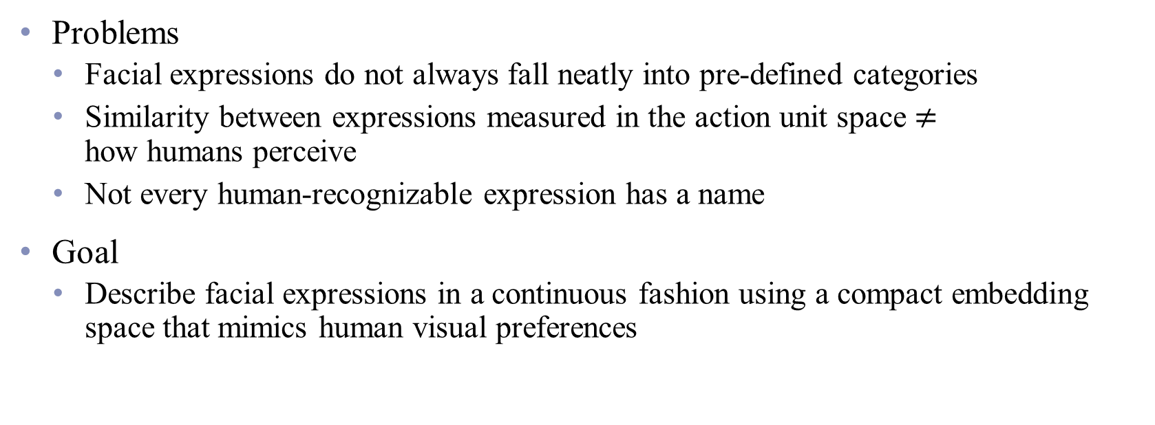
Introduction
Problems
Facial expressions do not always fall neatly into pre-defined categories
Similarity between expressions measured in the action unit space $≠$ how humans perceive
Not every human-recognizable expression has a name
Goal
Describe facial expressions in a continuous fashion using a compact embedding space that mimics human visual preferences

Slide 3
Related works
Categorical models
Facial Action Coding System (FAC) model
Dimensional models
e.g. Valence—Arousal

Slide 4
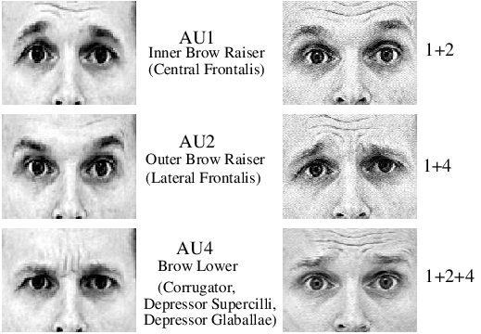
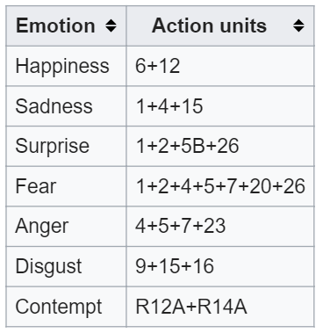
Facial Action Coding System (FACS) [1]
[1] P. Ekman, W. V. Friesen, and J. C. Hager. Facial Action Coding System - Manual. A Human Face, 2002.

Slide 5
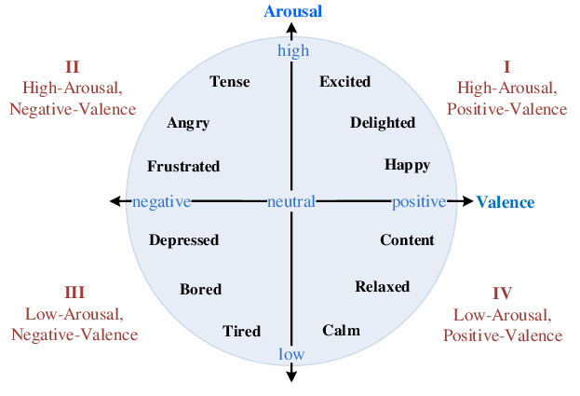
Valence—Arousal [2]
[2] J. A. Russell. A circumplex model of affect. Journal of Personality and Social Psychology, 39(6):1161–1178, 1980.

Slide 6
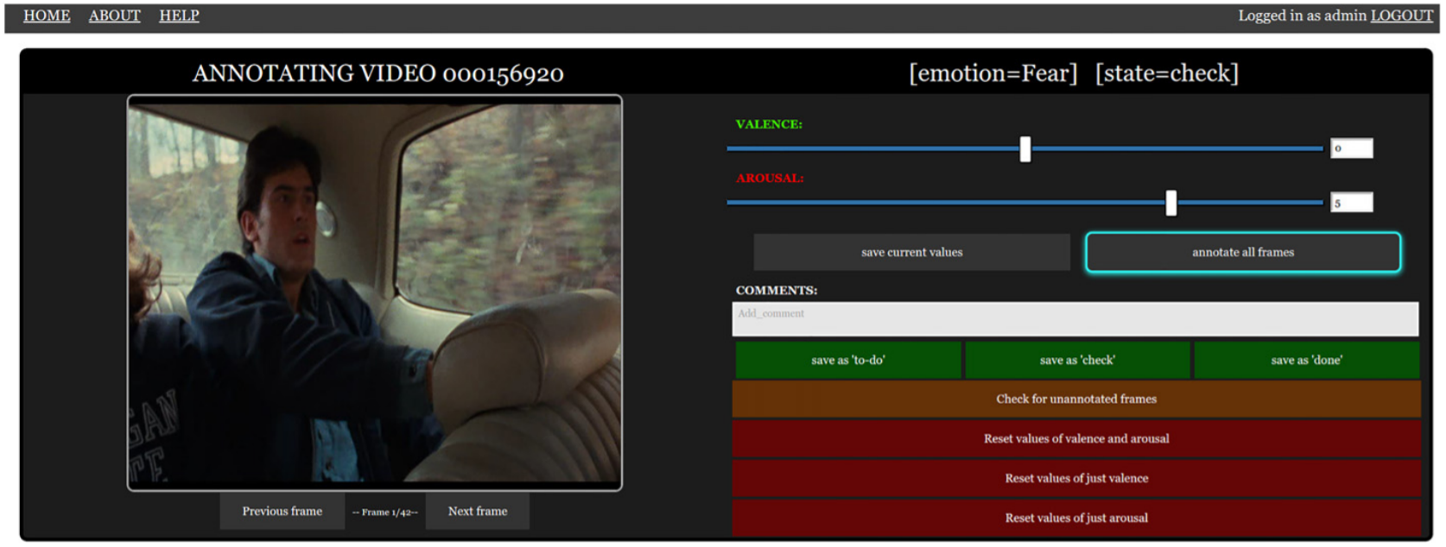
Valence—Arousal [2]
[2] J. A. Russell. A circumplex model of affect. Journal of Personality and Social Psychology, 39(6):1161–1178, 1980.

Slide 7
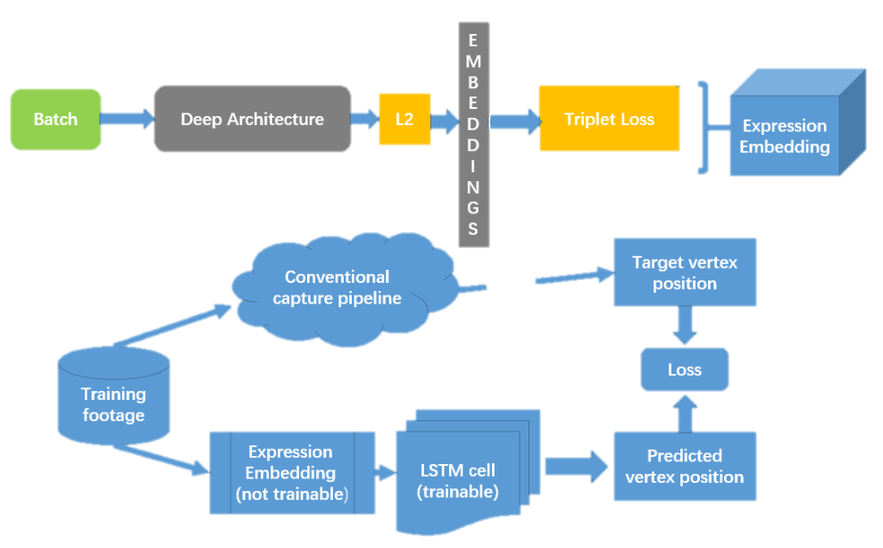
Expression embedding
LSTM-Based Facial Performance Capture Using Embedding Between Expressions [3]
[3] H. Meng, T. Lin, X. Jiang, Y. Lu, and J. Wen. LSTMbased facial performance capture using embedding between expressions. CoRR, abs/1805.03874, 2018.

Slide 8
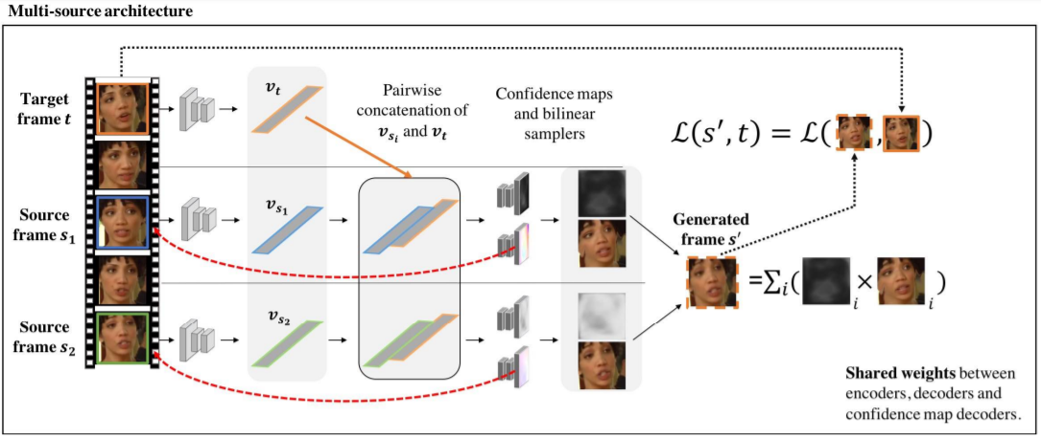
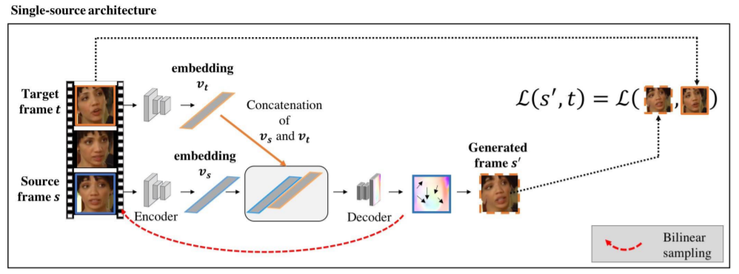
Expression embedding
Self-supervised learning of a facial attribute embedding from video [4]
[4] A. S. Koepke, O. Wiles, and A. Zisserman. Self-supervised learning of a facial attribute embedding from video. In BMVC, 2018.

Slide 9
Triplet loss-based representation learning
Category label-based triplets
Learn fine-grained representation
Use similarity measure to generate groundtruth annotations for the triplets [5]
Use text-image relevance based on Google image search to annotate the triplets [6]
[5] J. Wang, Y. Song, T. Leung, C. Rosenberg, J. Wang, J. Philbin, B. Chen, and Y. Wu. Learning fine-grained image similarity with deep ranking. In CVPR, 2014.
[6] G. Chechik, V. Sharma, U. Shalit, and S. Bengio. Large scale online learning of image similarity through ranking. Journal of Machine Learning Research, 11:1109–1135, 2010.

Slide 10
Facial Expression Comparison Dataset (FEC)
156K face images, 500K expression triplets generated
Human annotate which two expressions in each triplet are most similar
The first large-scale face-in-the-wild dataset with expression comparison annotations provided by human raters
16-dimensional expression embedding learned by training a deep neural network with FEC dataset
Expression-based application
Better than others learned using existing emotion or action unit datasets

Slide 11
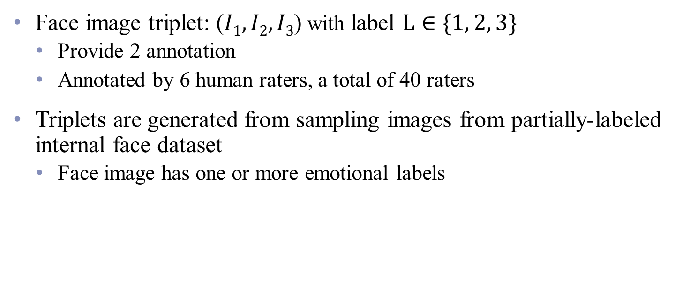
Facial Expression Comparison Dataset (FEC)
Face image triplet: ($I1, I2, I3$) with label $L∈\{1, 2, 3\}$
Provide 2 annotation
Annotated by 6 human raters, a total of 40 raters
Triplets are generated from sampling images from partially-labeled internal face dataset
Face image has one or more emotional labels
Amusement | Confusion | Disappointment | Elation | Nuetral | Sadness
Anger | Contemplation | Disgust | Embarrassment | Pain | Shame
Awe | Contempt | Distress | Fear | Pride | Surprise
Boredom | Contentment | Doubt | Interest | Realization | Sympathy
Concentration | Desire | Ecstasy | Love | Relief | Truimph

Slide 12
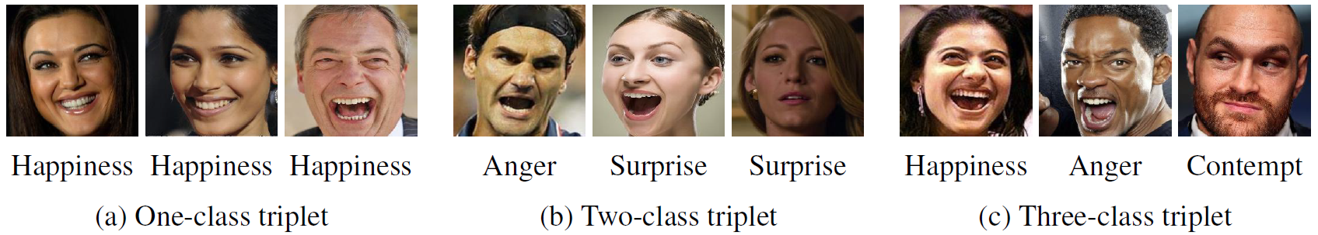
Facial Expression Comparison Dataset (FEC)
Q: Use the available emotion or action unit label to generate comparison annotation?
Most difficult
Easiest
Notes:
No information of within-class variation (a)
Same category expression need not be more similar (b)
Hard to predict similarity between expressions from 3 different emotion categories (c)
Difference in action units → distance function?

Slide 13
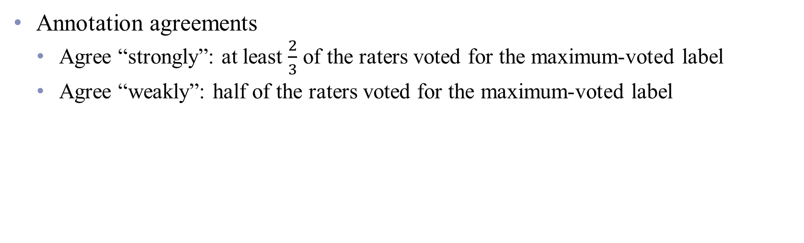
Facial Expression Comparison Dataset (FEC)
Annotation agreements
Agree “strongly”: at least $\frac{2}{3}$ of the raters voted for the maximum-voted label
Agree “weakly”: half of the raters voted for the maximum-voted label

Slide 14
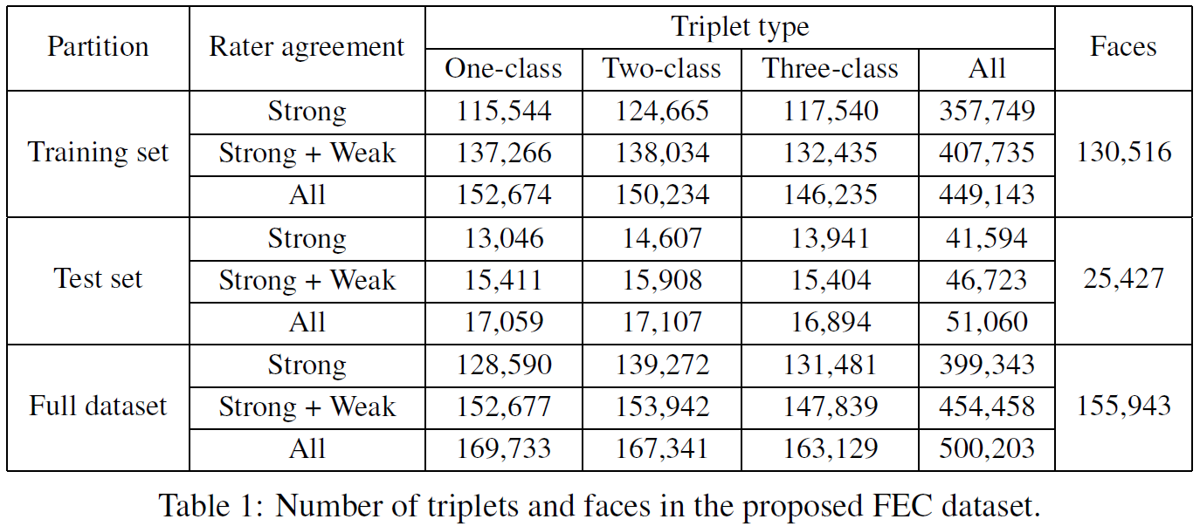
Facial Expression Comparison Dataset (FEC)
Training set: 90%
Test set: 10%

Slide 15
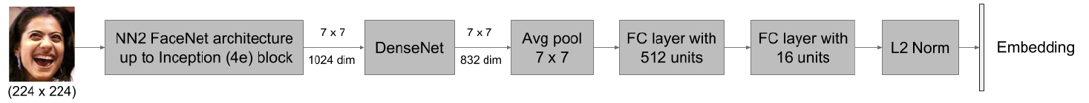
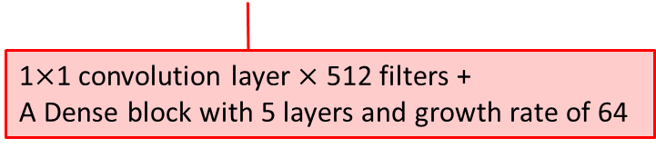
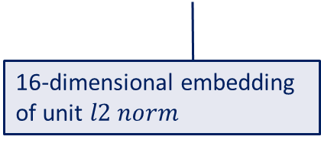
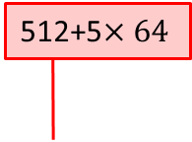
Facial expression embedding network
Feature map
512+5$×64$
Embedding layer
1$×$1 convolution layer $×$ 512 filters +
A Dense block with 5 layers and growth rate of 64
16-dimensional embedding
of unit $l2 norm$
Batch normalization and ReLu6 activation function are used in the DenseNet and the first FC layer.
Use dropout for regularization

Slide 16
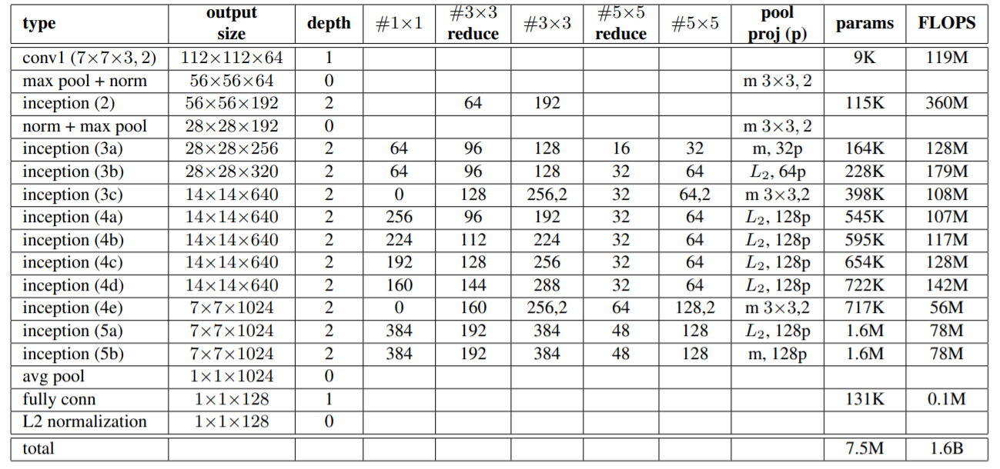
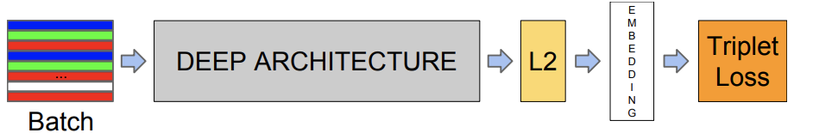
NN2 FaceNet [7]
[7] F. Schroff, D. Kalenichenko, and J. Philbin. FaceNet: A unified embedding for face recognition and clustering. In CVPR, 2015.

Slide 17
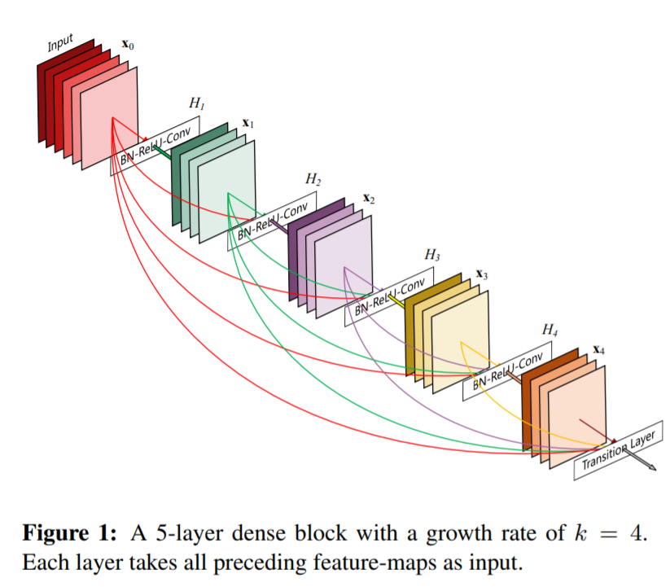
DenseNet [8]
[8] G. Huang, Z. Liu, L. van der Maaten, and K. Q. Weinberger. Densely connected convolutional networks. In CVPR, 2017.

Slide 18
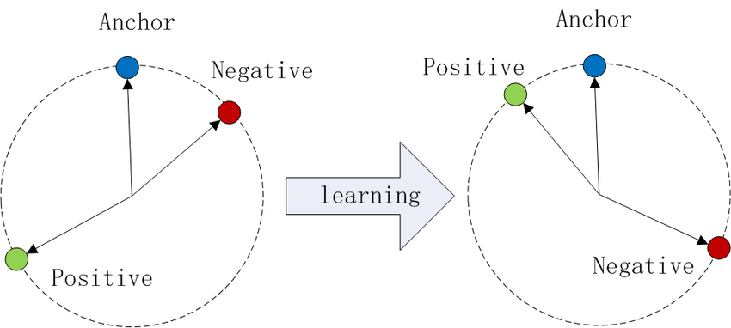
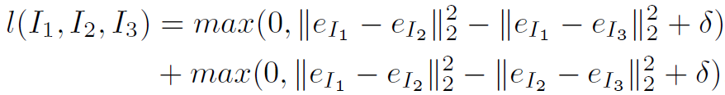
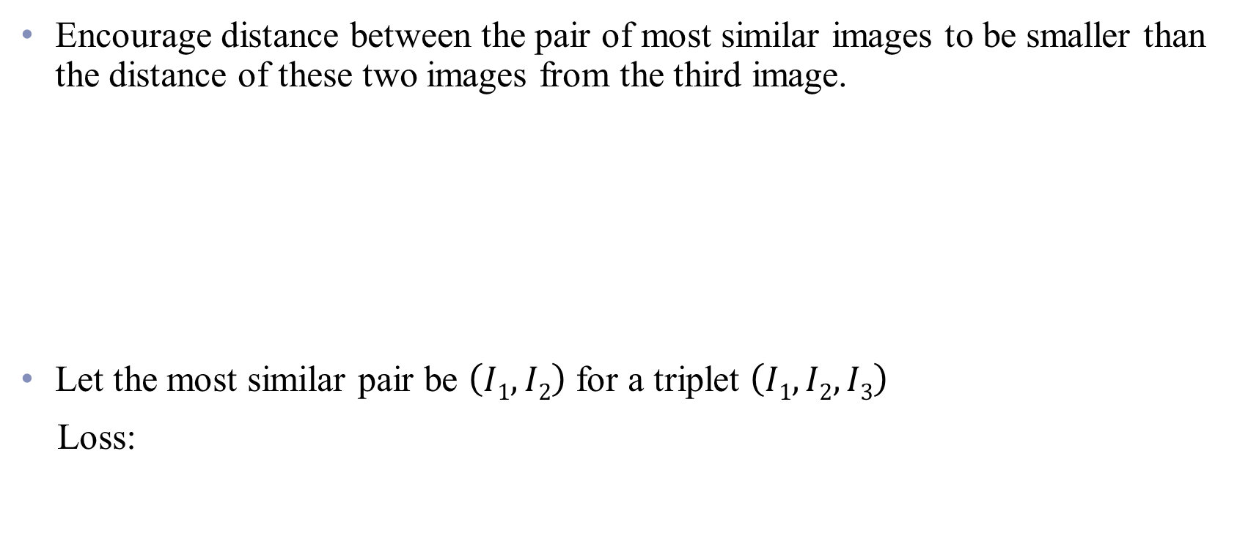
Triplet loss [7]
Encourage distance between the pair of most similar images to be smaller than the distance of these two images from the third image.
Let the most similar pair be $\left(I1, I2\right)$ for a triplet $\left(I1, I2, I3\right)$
Loss:

Slide 19
Experiments
Only use the triplets with strong rater agreement for both training and evaluation
AFFNet-CL
AffNet dataset [9]
Emotion recognition (8 emotions categories)
288K training images / 4K validation images
FACSNet-CL
DISFA dataset [10]
Facial action unit detection (12 AUs, manually labeled)
212K training images / 48K validation images
5 embeddings:
AFFNet-CL-P
AFFNet-CL-F
FACSNet-CL-P
FACSNet-CL-F
FACSNet-CL-TL
[9] A. Mollahosseini, B. Hassani, and M. H. Mahoor. Affect-Net: A database for facial expression, valence, and arousal computing in the wild. CoRR, abs/1708.03985, 2017.
[10] S. M. Mavadati, M. H. Mahoor, K. Bartlett, P. Trinh, and J. F. Cohn. DISFA: A spontaneous facial action intensity database. IEEE Transactions on Affective Computing, 4(2):151–160, 2013.

Slide 20
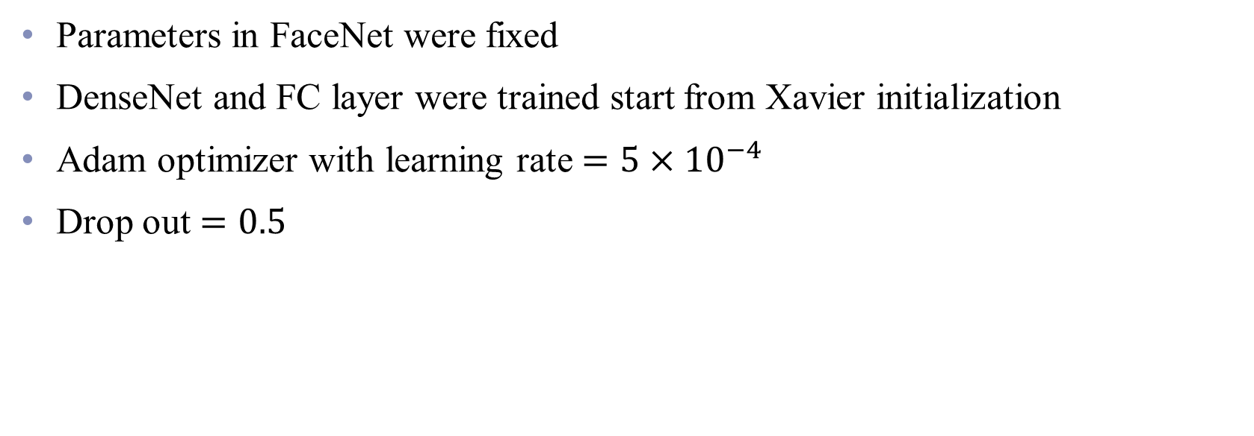
Training and validation
Parameters in FaceNet were fixed
DenseNet and FC layer were trained start from Xavier initialization
Adam optimizer with learning rate $=5×{10}^{−4}$
Drop out $=0.5$

Slide 21
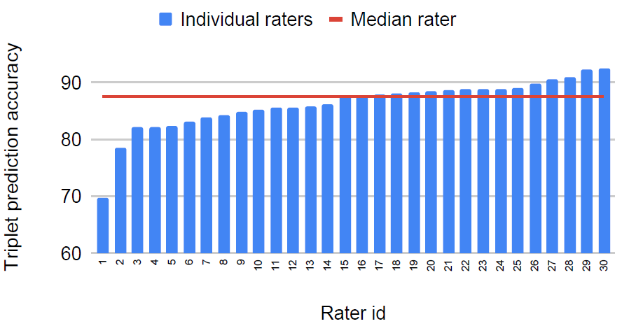
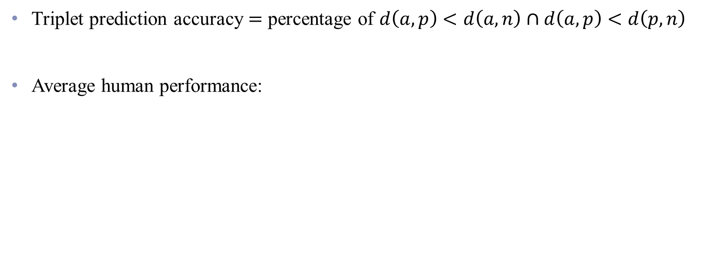
Training and validation
Triplet prediction accuracy $=$ percentage of $d\left(a,p\right)<d\left(a, n\right)∩d\left(a,p\right)<d\left(p, n\right)$
Average human performance:

Slide 22
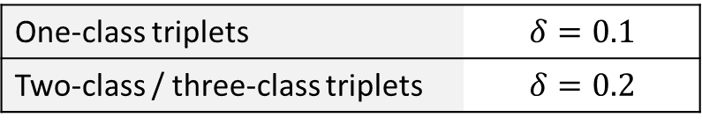
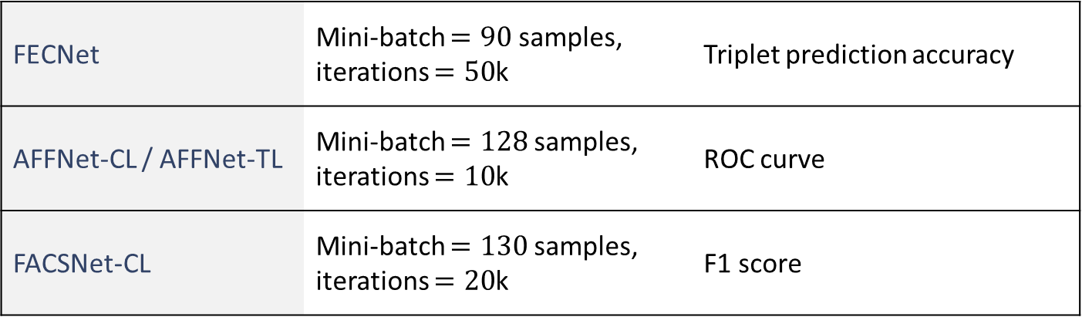
Training and validation
FECNet | Mini-batch $=90$samples, iterations $=50$k | Triplet prediction accuracy
AFFNet-CL / AFFNet-TL | Mini-batch $=128$samples, iterations $=10$k | ROC curve
FACSNet-CL | Mini-batch $=130$samples, iterations $=20$k | F1 score
One-class triplets | $$δ=0.1$$
Two-class / three-class triplets | $$δ=0.2$$

Slide 23
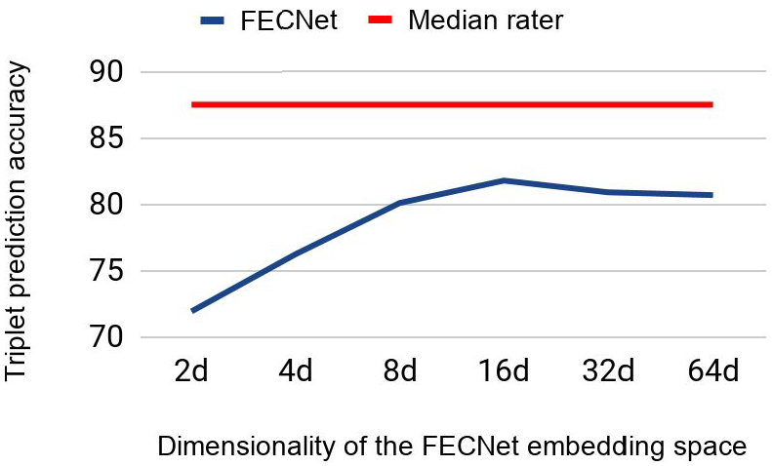
Dimensionality of the FECNet embedding
87.5%
81.8%

Slide 24
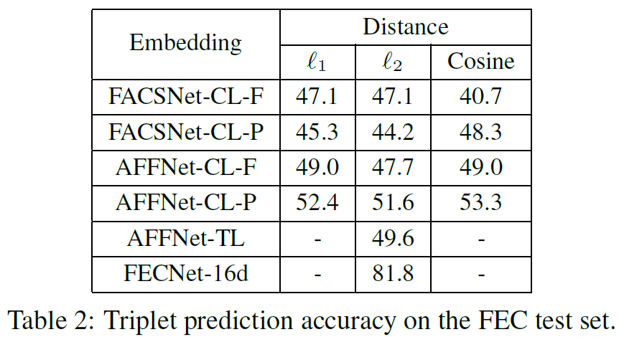
Comparison of embeddings

Slide 25
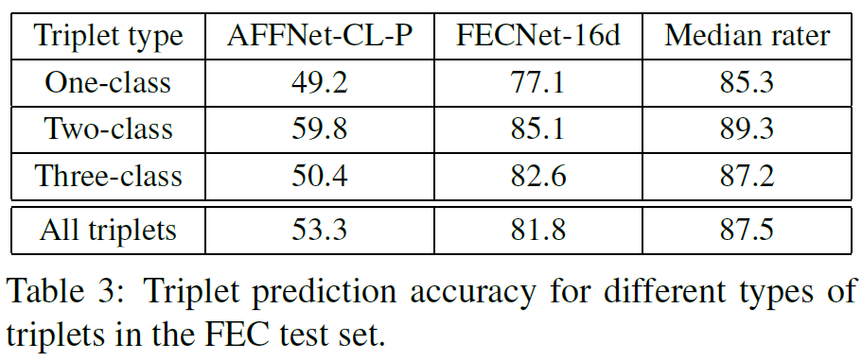
Comparison of triplets
The most difficult
Easiest

Slide 26
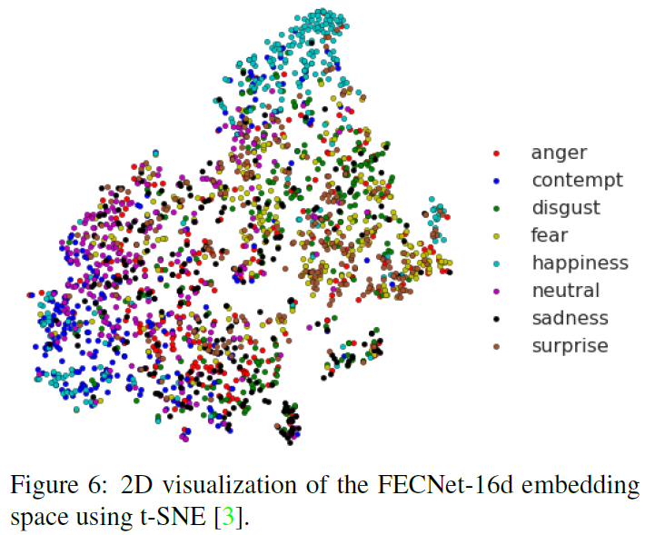
Visualization of FECNet embedding space

Slide 27
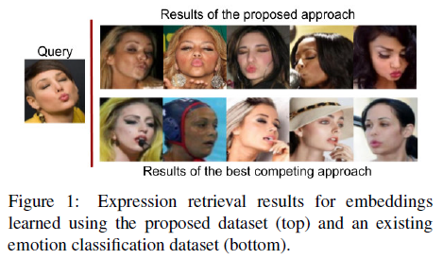
Application– image retrieval

Slide 28
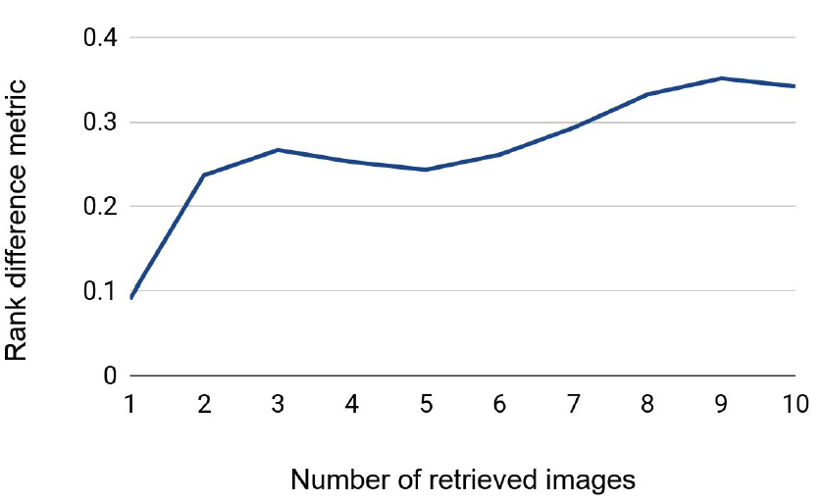
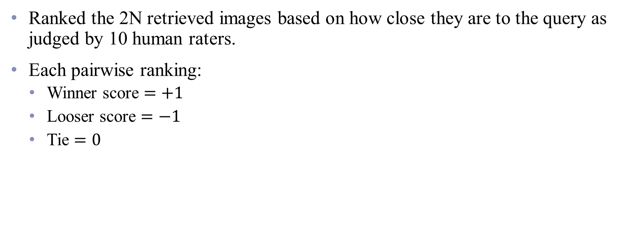
Application– image retrieval
Ranked the 2N retrieved images based on how close they are to the query as judged by 10 human raters.
Each pairwise ranking:
Winner score $=+1$
Looser score $=−1$
Tie $=0$

Slide 29
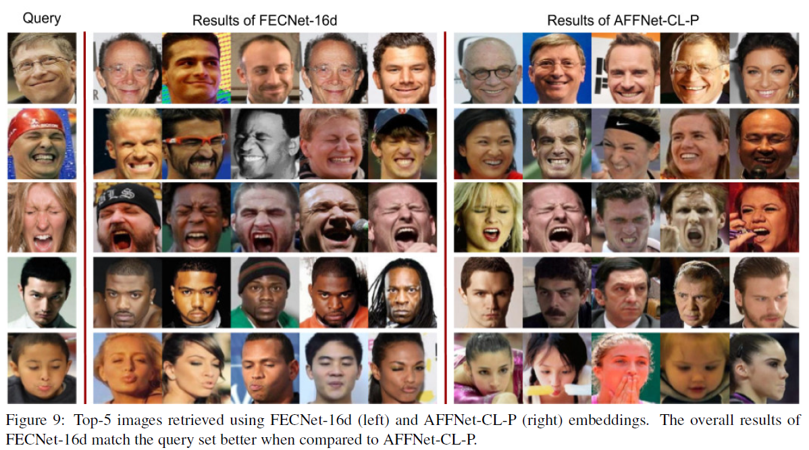
Application– image retrieval

Slide 30
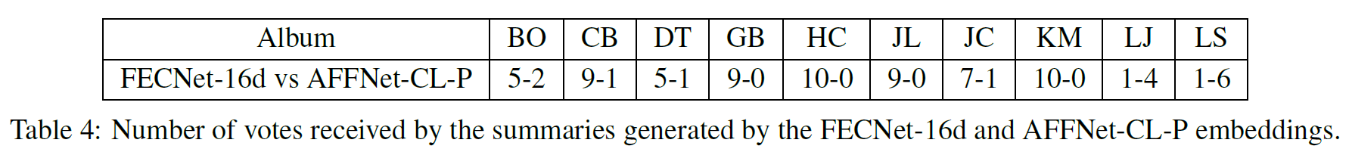
Application– photo album summarization

Slide 31
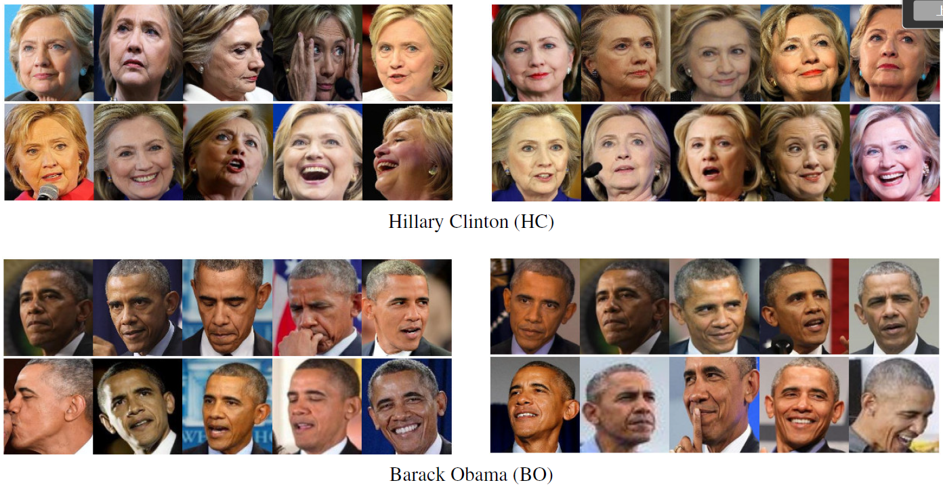
Application– photo album summarization
FECNet-16d
AFFNet-CL-P

Slide 32
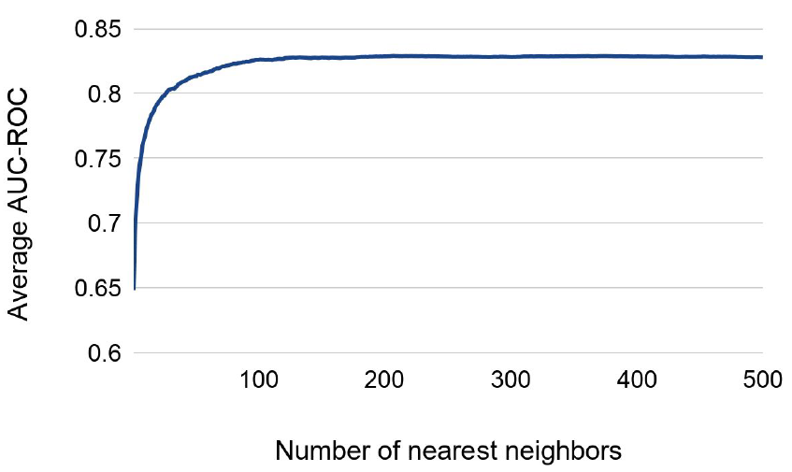
Application– emotion classification

Slide 33
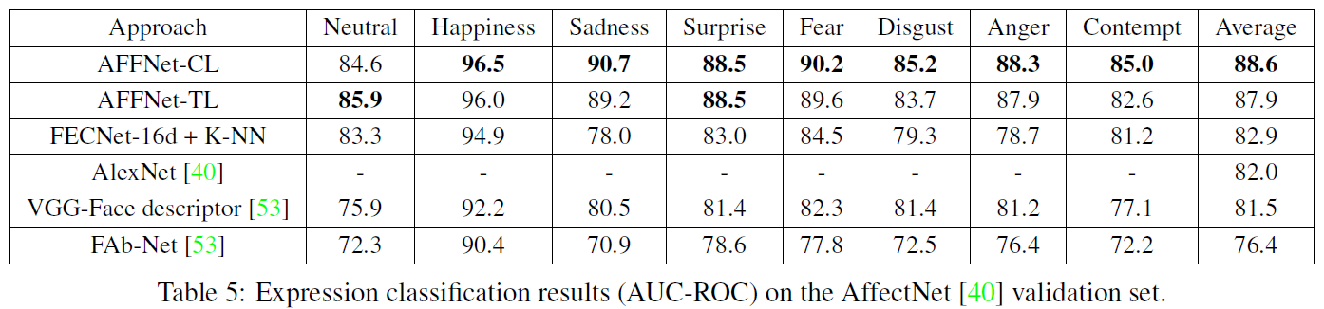
Application– emotion classification

Slide 34
Conclusion and future works
First large-scale facial expression comparison dataset annotated by human raters
Learned a compact (16-dim.) facial expression embedding with triplet loss.
Performs better than existing emotion and action units datasets
Usefulness for various applications
Hard negatives

Slide 35
Thanks for listening

Slide 36
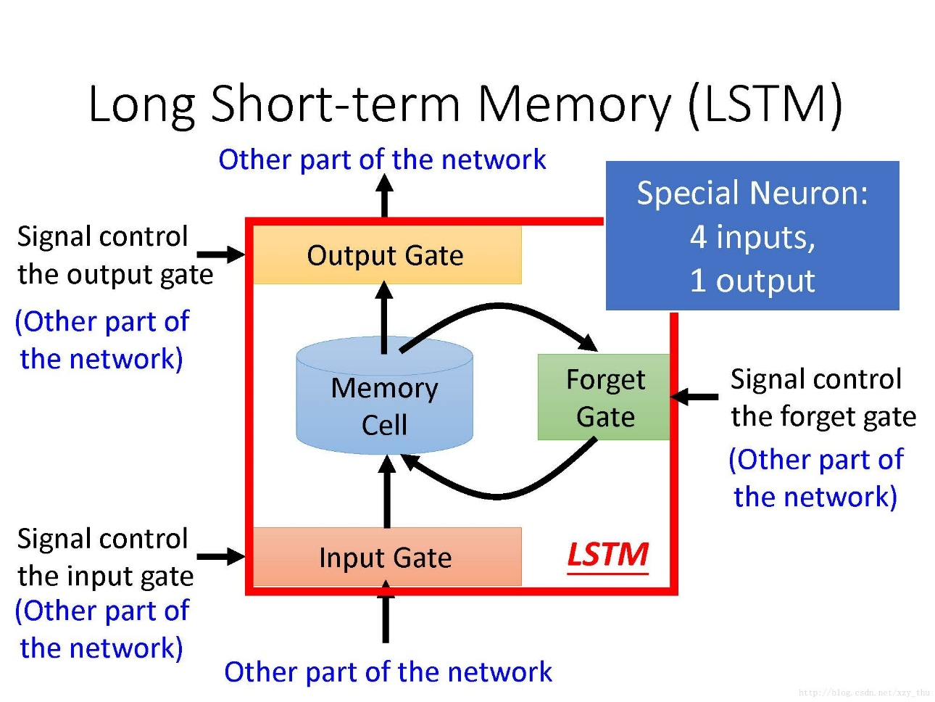

Slide 37
